Slide 1

A Claude-Assisted
Uranium and Nuclear Energy Investment Analysis
Short, Long + Alternate Nuclear
Xiaowen Chen (Xavier) · Ben Beauchamp · Jared Mount
Michael Kiernan · Shawyan Tabari · David Vargas
Fordham Gabelli School of Business · September 2026

Slide 2
Our Project Catalyst:
US Electricity Scarcity & Fossil Fuels Vilified
Decarbonization
Mandates push heating, transport and industry onto electricity
AI factory boom
US data centers:
4.4% of electricity 2023 6.7–12% by 2028
Supply stalled
New plant queues;
PJM 6.8GW Shortfall
@$325/MW-day
Community pushback
Protests over power, water and local impact
Demand Surges
Supply Lags
(Fossil Fuel Alternatives: Geothermal Fusion Hydro Nuclear Solar Wind)
Notes:
Sources: LBNL, 2024 United States Data Center Energy Usage Report (https://newscenter.lbl.gov/2025/01/15/berkeley-lab-report-evaluates-increase-in-electricity-demand-from-data-centers/); RTO Insider, PJM 2028/29 auction (https://www.rtoinsider.com/136577-pjm-capacity-auction-clears-325-cap-short-reliability-requirement/).

Slide 3
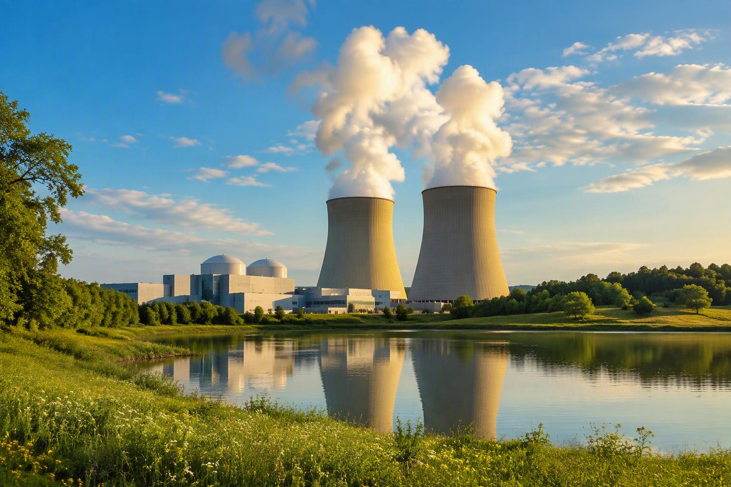
Where Is The Alternative Fossil Fuel Play?
We Believe Within The:
Nuclear Power Ecosystem

Slide 4
From mine to grid: where each company sits
Long and Short sit at the mine end; the Alternative covers the scarcer links
Dig
Develop
Store
Convert
Enrich
Fuel
Plug in
Design
CCJ
NXE
SPUT
SOLS
LEU
BWXT
CEG
SMR
KAP
DNN
OKLO
PDN
UEC
UUUU
Long / Short cohort
Short pick
Alternative cohort
Gap: not scored
Scarcest links: enrichment and grid-connected power.
Notes:
Sources: CLAUDE_WEEK_5_PROJECT_INSTRUCTIONS §3 (cohorts); REDTEAM_Nuclear_Equity_Criteria_Review_v3 (extended screen, Solstice); US DOE (waivers for Russian enriched uranium end no later than Jan 1, 2028).

Slide 5
Is the Play Short, Long or Alternative?
Answer: None of the Above.
Mandate | Call | What would change it | Signed off
Short | Watchlist: short UUUU | VAC terms confirmed Exit above $16.12 | Jared Mount Sep 26
Long | Watchlist: Paladin | Price ≤ A$8.59 Or 20% upside on re-test | Xiaowen Chen Sep 27
Alternative | Watchlist: BWXT | Price near $133 Or a higher target | Shawyan Tabari Sep 28
No link in the chain clears our bar yet:
mining, fuel and reactors all rank Watchlist.
Notes:
Sources: Kazatomprom 1H2026 results (spot US$85.98/lb; realized US$67.88/lb); SHORT_Mandate_Research_Matrix (Jared Mount, signed off Sep 26); LONG_Mandate_Research_Matrix_Xiaowen_Chen_2026-09-27 (signed off Sep 27); COUNCIL_REVIEW_Alternative_Claude_2026-09-27 (Watchlist adopted by Michael Kiernan as interim chair, Sep 27, then reviewed and signed off by Shawyan Tabari as human chair, Sep 28, assisted by David Vargas).

Slide 6




How we worked
Claude on our shared drive; the analysts own every call
1
Research
Score every company, with sources
2
Council review
Five AI personas challenge each call
3
Human sign-off
The analyst, as chair, makes the call
4
Log it
Every decision in a shared ledger
Tools: Claude + shared Google Drive · Check: GPT Sol 6.0
Notes:
Sources: CLAUDE_WEEK_5_PROJECT_INSTRUCTIONS, Sections 2, 4 and 5; Week 5 Team Project Guide in Claude; TEAM_PROJECT_WEEK_5_MEMORY.

Slide 7
Evaluation Criteria

Slide 8




How we pick stocks
One set of criteria, three ways to use it
1 Screen
2 Score
3 Mandate
4 Act
Public, liquid, tradable
Score 1–5, weighted
Long, Short, or Alternative
Entry, exit, size, or no trade
LONG
SHORT
ALTERNATIVE
Own the best business at the right price
Bet against what breaks
A better exposure in the supply chain
Notes:
Sources: Ben Beauchamp's evaluation criteria (revised Sep 25, 2026); REDTEAM_Nuclear_Equity_Criteria_Review_v3.

Slide 9






Seven questions for every stock
Five weighted factors, plus two added for shorts and execution
Valuation
Room for a return?
25%
Cash economics
Uranium price → cash?
20%
Growth
Credible in our horizon?
20%
Resilience
Can it fund and deliver?
20%
Market confirmation
Price backed by fundamentals?
15%
Short feasibility
Can we short it?
Must pass
Execution plan
What do we do, and when?
Required
Notes:
Sources: Ben Beauchamp's evaluation criteria; REDTEAM_Nuclear_Equity_Criteria_Review_v3.

Slide 10



LONG: own the best business at the right price
HORIZON
24–36 months
Producer
In construction
Diversified
Cash cost vs. realized price
Contract coverage
FCF yield
P/NAV · EV per lb
On schedule
On budget
Funding gap
Sum-of-parts
Segment cash margins
Backlog conversion
WATCH THESE
PDN
KAP
CCJ
UEC
UUUU
NXE
DNN
Verdict: Long · Stage entry · Watchlist · No trade
Notes:
Sources: LONG_Mandate_Research_Matrix_Xiaowen_Chen_2026-09-27; Week 4 Cameco analysis (benchmark).

Slide 11






SHORT: bet against what breaks
HORIZON
3–6 months
RED FLAGS
Priced for perfection
Margins squeezed
Delays and overruns
Funding gap
Price up, estimates down
MUST PASS BEFORE SHORTING
Borrowable?
Squeeze risk low?
Dated catalyst?
WATCH THESE
CCJ
KAP
PDN
UEC
UUUU
NXE
DNN
EU
URG
Notes:
Sources: SHORT_Mandate_Research_Matrix (Jared Mount).

Slide 12






ALTERNATIVE: a better bet in the chain?
HORIZON
Set by direction
Physical
Fuel cycle
Components
Generation
Reactors
NAV discount
SWU price, backlog
Book-to-bill
Contracted MW
Licensing, cash runway
SPUT
LEU
BWXT
CEG
SMR
OKLO
Nuclear revenue
Beats our best calls?
Majority (50%+) of revenue from nuclear
Better than the best Long or Short
Notes:
Sources: ALT_Vertical_Mandate_Research_Matrix; CLAUDE_WEEK_5_PROJECT_INSTRUCTIONS §3B and §6.

Slide 13
Company Ranking: One score per company, across all three mandates
Chain step | Company | Val | Cash | Growth | Resil. | Mkt | Score | Verdict
Dig | PDN | 3 | 4 | 4 | 4 | 5 | 3.90 | Long lead · Watchlist
Dig | KAP | 3 | 3 | 2 | 2 | 5 | 2.90 | Long C · conditional
Dig | UEC | 3 | 4 | 2 | 2 | 1 | 2.50 | Not selected: low score
Dig + REE | UUUU | 3 | 2 | 3 | 3 | 1 | 2.50 | Short call · Watchlist
Integrated | CCJ | 2 | 3 | 3 | 5 | 3 | 3.15 | Watchlist: gate untested
Develop | NXE | 2 | 2 | 5 | 5 | 3 | 3.35 | Watchlist: first ore 2030
Develop | DNN | 2 | 2 | 5 | 3 | 4 | 3.10 | Long B · on milestones
Store | SPUT | 5 | 4 | 2 | 4 | 4 | 3.85 | Alt runner-up
Enrich | LEU | 2 | 2 | 4 | 2 | 1 | 2.25 | Not selected: 229x
Fuel & build | BWXT | 3 | 4 | 5 | 4 | 3 | 3.80 | Alt lead · Watchlist
Plug in | CEG | 3 | 4 | 4 | 3 | 3 | 3.40 | Ineligible (est.)
Design | SMR | 2 | 1 | 2 | 2 | 1 | 1.65 | Watchlist short
Design | OKLO | 1 | 1 | 2 | 2 | 1 | 1.40 | Ineligible
One score per name: Jared aligned the Short scores to these on Sep 28 (slide 15).
Notes:
Sources: SHORT_Mandate_Research_Matrix (signed off Sep 26); LONG_Mandate_Research_Matrix_Xiaowen_Chen_2026-09-27 (signed off Sep 27); ALT_Vertical_Mandate_Research_Matrix_DRAFT_Claude_2026-09-26.

Slide 14
Short Analysis

Slide 15
Short: what we screened and why
Company | Type | Val | Cash | Growth | Resil. | Mkt | Score | Verdict
CCJ | Integrated producer | 2 | 3 | 3 | 5 | 3 | 3.15 | Lead: squeeze risk
KAP | GDR producer | 3 | 3 | 2 | 2 | 5 | 2.90 | Lead: fails feasibility
PDN | ASX/TSX producer | 3 | 4 | 4 | 4 | 5 | 3.90 | No short: resolved
UEC | US ISR producer | 3 | 4 | 2 | 2 | 1 | 2.50 | Watchlist: mixed
UUUU | Diversified | 3 | 2 | 3 | 3 | 1 | 2.50 | Short call: Watchlist
NXE | Construction-stage | 2 | 2 | 5 | 5 | 3 | 3.35 | No short: resolved
DNN | Construction-stage | 2 | 2 | 5 | 3 | 4 | 3.10 | No short: resolved
Notes:
Sources: Scores: SHORT_Mandate_Research_Matrix, signed off by Jared Mount (human chair), Sep 26, 2026, then reconciled with the Long matrix on Sep 28, 2026. Market confirmation is the measured 12-1 month return against the seven-name average (Yahoo Finance closes). Other sources: SEC 8-K filings; FINRA short interest via equibles.com; companiesmarketcap.com (Interactive Brokers borrow data).

Slide 16
Energy Fuels (UUUU): the VAC dilution mechanism
The deal
What’s not priced in
VAC priced at $16.12/share (Jun 22)
$718M cash + 65.9M new shares (~26% dilution)
Below $20.93, Ara gets up to $135M more preferred
Close expected early 2027
Consensus: Strong Buy, $24.15 avg target
Loan: $725M gov’t loan funds the mill, not VAC
Funding: $250M Goldman loan + cash, not equity
Sizing: $135M cap ≈ 4.7% of market cap
Bottom line: a specific, dated mechanism. Is it priced in?
Notes:
Sources: Detail: SHORT_Mandate_Research_Matrix · Energy Fuels 8-K, Jun 26, 2026 (Items 1.01, 8.01) · Energy Fuels press release, Jun 23, 2026

Slide 17
Where the price sits and our view
$11.35
$16.12
$20.93
$24.15
$9.00–$9.65
$10
$15
$20
$25
Our target range
Current price
Deal price / stop level
Preferred-share trigger
Street consensus target
Our view: the stock sits closer to our downside target than to the deal price it needs to reclaim to kill the thesis — but it also sits well below the $24.15 Street consensus, which is the strongest open question.
Notes:
Sources: Prices as of Sep 25, 2026 close (stockanalysis.com). Deal terms: Energy Fuels 8-K, Jun 23–26, 2026.

Slide 18
Energy Fuels (UUUU): Watchlist, not a clean Short
Factor 6: must pass
Execution plan
Borrow: 0.57%, 850K shares: pass
Short interest: 22.3% of float, elevated
Days to cover: 8.91 and rising
Squeeze Score 73/100: keeps it Watchlist
Entry: only after VAC terms are confirmed
Target (3–6 mo): $9.00–$9.65
Cover: clean close, better terms, or no deal
Size: ~1% of NAV; squeeze risk caps it
Dissent (Street): $24.15 avg target. Flip: days to cover < 6 twice; exit above $16.12.
Notes:
Sources: Factor 6 detail: SHORT_Mandate_Research_Matrix, Section 4 · FINRA short interest via equibles.com, Sep 15, 2026 settlement · Interactive Brokers borrow data via companiesmarketcap.com

Slide 19
Council Review: pressure-testing the call
What the Council found
What changed as a result
Am I Deluded? Slightly one-sided toward dilution
Attack the Deal: main risk is a rare-earth squeeze
Stress Test: a squeeze could hit before dilution
Read My Excuse: Watchlist is warranted
Rationale: rare-earth counter-case added
Plan: flip and exit conditions added
Correction: “CEO purchase” was wrong: sales
Sign-off: Jared Mount, Sep 26
Recommendation: sourced, verifiable, sign-off ready.
Notes:
Sources: Detail: COUNCIL_REVIEW_Short_Jared_Mount_2026-09-26 (03_Deliverables_and_Memos)

Slide 20
Long Analysis

Slide 21
The ranking result for the long position
Company | Type | Val | Cash | Growth | Resil. | Mkt | Score | Verdict
PDN | ASX/TSX producer | 3 | 4 | 4 | 4 | 5 | 3.90 | Long A: Watchlist
NXE | Construction-stage | 2 | 2 | 5 | 5 | 3 | 3.35 | Watchlist: ore 2030
CCJ | Integrated producer | 2 | 3 | 3 | 5 | 3 | 3.15 | Watchlist: gate untested
DNN | Construction-stage | 2 | 2 | 5 | 3 | 4 | 3.10 | Potential Long: on milestones
KAP | Kazakh ISR producer | 3 | 3 | 2 | 2 | 5 | 2.90 | Conditional long
UEC | US ISR producer | 3 | 4 | 2 | 2 | 1 | 2.50 | Not selected: low score
UUUU | Diversified | 3 | 2 | 3 | 3 | 1 | 2.50 | Excluded: Short pick
How we ranked: Weights 25/20/20/20/15; market confirmation = 12-1 month return vs. the seven-name average.

Slide 22
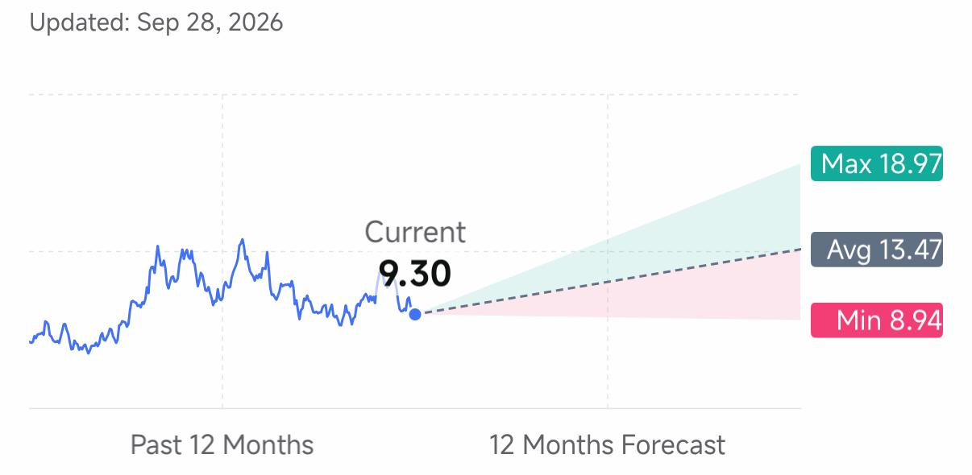
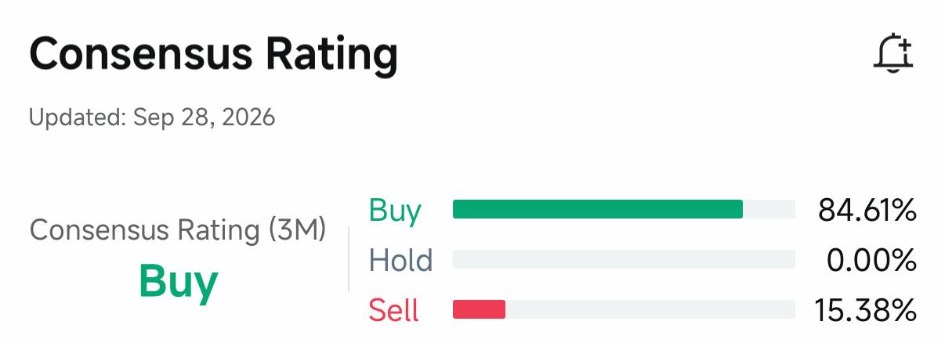
Paladin – Analyst rating (85% Buy)
Source: FUTU Securities, Code PDN, data fetched Sep 28, 2026

Slide 23
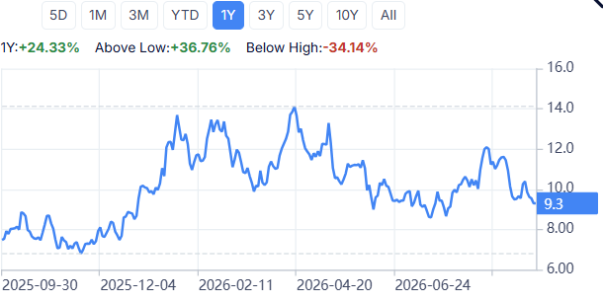
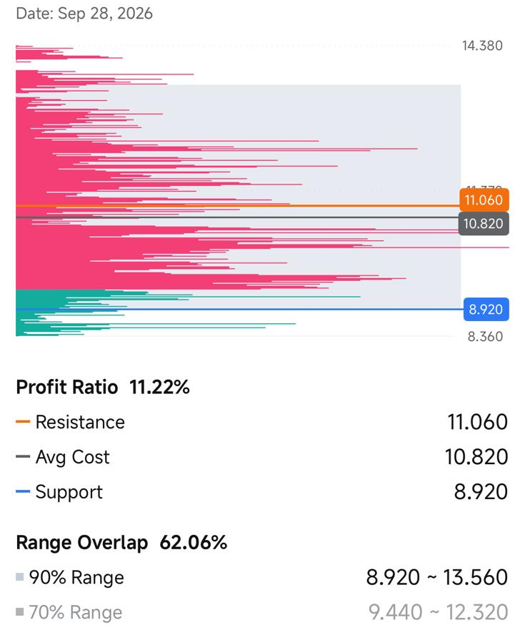
Paladin – Stock Sentiment: Huge drag down & Low Profit Ratio
Drag down from peak -34%
Source: FUTU Securities, Code PDN, data fetched Sep 28, 2026

Slide 24
Long: what we buy
Ramp-up delivered: FY26 output of 4.82 Mlb landed at the top of guidance, and FY27 is guided up to 5.1–5.6 Mlb.
Price upside built in: Paladin sold at an average of US$70/lb while the long-term contract price sits around US$96.5/lb. Over 85% of LHM reserve.
Growth potential: Canada's PLS project: about 9 Mlb a year at a US$15.20/lb all-in cost, with commissioning targeted for 2031.
Source:https://www.paladinenergy.com/wp-content/uploads/2026/09/Paladin-Energy-Investor-Day-Presentation.pdf
Notes:
Sources: Paladin Energy Investor Day, Sep 2, 2026 (https://www.paladinenergy.com/wp-content/uploads/2026/09/Paladin-Energy-Investor-Day-Presentation.pdf) · Paladin FY2026 MD&A (Aug 26, 2026) and FY2027 guidance (Jul 22, 2026) · LONG_Mandate_Research_Matrix_Xiaowen_Chen_2026-09-27.

Slide 25
Paladin’s multiple vs. peers
REFERENCE SHARE PRICE
FY2028 CONSENSUS EBITDA
12-MONTH TARGET
A$9.55
10.9×
A$10.31
Enterprise value ≈ US$2.78bn
FY2027 multiple: 14.5×
+8%
FORWARD MULTIPLE SENSITIVITY / FY2028
TRAILING PEERS
10.9×
12× target
13.4× gate
KAP
7.8×
Reference
CCJ
68×
10×
14×
BOE
27×
A$8.70
A$11.92
Tested range: 10–14× | A$8.70–11.92
Different reporting periods
and business stages
Source: https://stockanalysis.com/stocks/ccj/statistics/

Slide 26
Paladin: Investment plan
Execution plan
Our worries:
Langer Heinrich output ceiling: Ord Minnett doesn't expect the mine to sustain its 6 Mlb nameplate for a full year and cut FY28–30 to 5.7 Mlb.
PLS funding:
A potential significant capital raise
Entry: ≤ A$8.59, or a target ≥ A$11.46
Target: A$10.31 (+8%); gate not met
Exit review: A$8.12, or a guidance cut
Size: up to 1.60% of NAV
Notes:
Sources: Detail: LONG_Mandate_Research_Matrix_Xiaowen_Chen_2026-09-27 · Paladin FY2026 MD&A (Aug 26, 2026) and FY2027 guidance (Jul 22, 2026) · consensus: MarketScreener, FNArena (Sep 2026) · Ord Minnett forecast (FY28–30 at 5.7 Mlb): source to be added by Xiaowen Chen.

Slide 27
Potential Long - Denison: construction-stage upside
Thesis
Execution plan
95% of Wheeler River; FID Feb 2026
Study opex US$6.28/lb (2023)
Capex ~C$600M; output mid-2028
Value rises as risk falls
Entry: ≥30% upside
Funding test: costs covered + 20% cushion
Exit review: 6-month slip or +15% cost
Size: 0.80% of NAV, on milestones
Dissent: US$6.28/lb is a study number; a 2-year delay cuts value ~17%.
Sources: Detail: IC Memo §3.3 · Denison FID (Feb 24, 2026); Q2 2026 results (Aug 12, 2026); Phoenix feasibility highlights

Slide 28
Potential Long - Kazatomprom: low cost, if the cash gets out
Thesis
Execution plan
Largest ISR producer
H1 C1 cost US$24.48/lb
AISC US$38.45 vs. realized US$67.88
FY AISC guide up: US$39.00–40.50
Screen first: custody, dividends, sanctions
Entry: ≥30% upside to cash-flow value
Exit review: route, tax or access change
Size: 0.60% of NAV; cash if a check fails
Dissent: jurisdiction risk and rising costs erode the low-cost edge.
Sources: Detail: IC Memo §3.4 · Kazatomprom H1 2026 results RNS (Aug 21, 2026)

Slide 29
Long position viewed by different Philosophies

Slide 30
Six different investment philosophies on one asset
Author | Book | Style
Peter Lynch | One Up on Wall Street | Growth at a reasonable price
Thornton L. O’glove | Quality of Earnings | Forensic accounting
Benjamin Graham | Security Analysis | Deep value, margin of safety
Nassim Taleb | The Black Swan | Tail risk, barbell
Morgan Housel | The Psychology of Money | Behavioral finance
Tim Koller | Valuation | Corporate valuation (DCF)
Notes:
Sources: Peter Lynch, One Up on Wall Street; Thornton L. O'glove, Quality of Earnings; Benjamin Graham, Security Analysis; Nassim Taleb, The Black Swan; Morgan Housel, The Psychology of Money; Tim Koller et al., Valuation.

Slide 31
Six philosophies, three stocks
Lens | Paladin (A) | Denison (B) | Kazatomprom (C)
Lynch | Track the ramp; don’t overpay | Own only on milestones | Hard to know from here
O’glove | Cost must show in cash flow | Inventory sales aren’t mine cash | Dividends need cash cover
Graham | No margin of safety at 86x | Speculative until it produces | Cheap only if we get paid
Taleb | One mine: one point of failure | Small bet, big upside | Sanctions risk hard to size
Housel | Cash gives room; price doesn’t | Much must go right: keep small | Size so being wrong is OK
Koller | Mine DCF + PLS option | DCF with delay cases | Country-risk scenarios
Agree: Paladin is best, but re-test the price; DNN and KAP stay small.
Differ: Taleb likes Denison’s upside; Graham and O’glove want cash first.
Notes:
Sources: the six books on slide 30; the views are the team's application of each book.

Slide 32
Catalysts to watch and scenarios
Case | Spot / Term | Paladin (A) | Denison (B) | Kazatomprom (C)
Bear | $60 / $75 | Margin squeezed | Funding pressure | Costs squeeze margin
Base | $95 / $100 | Ramp lifts cash | Value builds | Solid if costs hold
Bull | $120 / $115 | More cash, lagged | Most upside | More cash if paid out
Next 90 days: Paladin report (~Oct 21–22), AGM (Nov 17), sleeve review (Nov 9).
Through 2027: Phoenix build, PLS licensing, Kazatomprom costs.
2028: Russian-uranium waivers end; Phoenix first output.
Notes:
Sources: IC Memo §4.3 and §6; Paladin FY2027 guidance (Jul 22, 2026).

Slide 33
Council Review: pressure-testing the Long call
What the Council found
What changed as a result
Am I Deluded? Not yet: 3 of 7 names ranked
Attack the Deal: 20% gate had no valuation
Stress Test: a 61x P/E can compress
Read My Excuse: KAP delay real; CCJ’s avoidable
Ranking: all seven re-scored; Paladin leads
SPUT: moved to the Alternative
Re-test: Paladin +8%: Watchlist
Sign-off: Xiaowen Chen, Sep 27
Still open: Cameco valuation (Oct 30), KAP access, Denison funding.
Analysis: Xiaowen Chen; slide: Claude
Notes:
Sources: Detail: COUNCIL_REVIEW_Long_Xiaowen_Chen_2026-09-27 (https://docs.google.com/document/d/1Jpmu-nybWhvZJ8khx10em6AJOMqp98pT8dC_yFiGVW0/edit) (Rev. 3) · LONG_Mandate_Research_Matrix_Xiaowen_Chen_2026-09-27 (https://docs.google.com/document/d/1K7mopTixxJ2JqoyJ6qdVTvjMPMTeSOO_fptjoHgXqxE/edit) (sign-off)

Slide 34
Alternative Investment:
Vertical Supply Chain

Slide 35
How the six qualified as Alternatives
Name | Segment | Nuclear share of revenue | Result
SPUT | Physical uranium | None: holds uranium (98%+ of assets) | Pass: uranium-fund rule
BWXT | Components & services | Gov. Ops segment 73% (FY2025 10-K) | Pass
CEG | Generation | ~28–38% (est.); not disclosed | Ineligible (estimate)
LEU | Enrichment | ~100% (est.) | Pass
SMR | Advanced reactors | 100%, but $10.7M revenue | Pass; no binding orders
OKLO | Advanced reactors | $1.21M services; Meta prepayment | Not yet: prepayment ≠ contract
Listed and liquid: all six pass.
Nuclear revenue: majority (50%+) from nuclear power; uranium funds (90%+) qualify.
Beats our best calls? BWXT ~15% upside vs. Paladin ~8%; neither clears 20%.
Slide: Claude
Notes:
Sources: Rules: CLAUDE_WEEK_5_PROJECT_INSTRUCTIONS (https://docs.google.com/document/d/1ObDdAqX1uep6v_xQuRnUmeMMtNivBAD3DO5MCyAZP2c/edit) §3B, §6 · Sprott (https://sprott.com/investment-strategies/physical-commodity-funds/uranium/) · BWXT FY2025 10-K (https://www.sec.gov/Archives/edgar/data/1486957/000148695726000007/bwxt-20251231.htm) · CEG Q2 2026 (https://www.constellationenergy.com/news/2026/08/constellation-reports-second-quarter-2026-results.html) · Centrus Q2 2026 (https://www.prnewswire.com/news-releases/centrus-reports-second-quarter-2026-results-302843983.html) · NuScale Q2 2026 (https://www.nuscalepower.com/press-releases/2026/nuscale-power-reports-second-quarter-2026-results) · Oklo 10-Q (https://www.sec.gov/Archives/edgar/data/1849056/000162828026054571/oklo-20260630.htm), Meta agreement (https://oklo.com/newsroom/news-details/2026/Oklo-Meta-Announce-Agreement-in-Support-of-1-2-GW-Nuclear-Energy-Development-in-Southern-Ohio/default.aspx) · Estimates: ALT draft §1 (https://docs.google.com/document/d/1_QWehVyT3AkP6-klJpIgFUbes-qFehNv8MG1QzGN4lg/edit)

Slide 36
Alternative: BWXT on the Watchlist
Company | Segment | Val | Cash | Growth | Resil. | Mkt | Score | Verdict
SPUT | Physical uranium | 5 | 4 | 2 | 4 | 4 | 3.85 | Runner-up
BWXT | Components | 3 | 4 | 5 | 4 | 3 | 3.80 | Watchlist (lead)
CEG | Generation | 3 | 4 | 4 | 3 | 3 | 3.40 | Ineligible
LEU | Enrichment | 2 | 2 | 4 | 2 | 1 | 2.25 | Not selected: 229x
SMR | Adv. reactors | 2 | 1 | 2 | 2 | 1 | 1.65 | Watchlist short
OKLO | Adv. reactors | 1 | 1 | 2 | 2 | 1 | 1.40 | Ineligible
Human chair: Shawyan Tabari. Verdict: Watchlist (BWXT lead).
Our read: We're confident BWXT is the right Alternative pick, even though SPUT scores slightly higher. Owning SPUT would concentrate the uranium bet we already make through the miners.
BWXT is the only company building reactors for the Navy's submarines and carriers, so it gets paid whether uranium goes up or down. The only problem is price. Upside today is about 15% and our bar is 20%, so for now it stays on the Watchlist.
Notes:
Sources: BWXT Q2 2026 release (https://www.businesswire.com/news/home/20260803655700/en/BWX-Technologies-Reports-Second-Quarter-2026-Results) · Sprott SPUT page (https://sprott.com/investment-strategies/physical-commodity-funds/uranium/) · Cameco price indicators (https://www.cameco.com/invest/markets/uranium-price) · CEG (https://www.constellationenergy.com/news/2026/08/constellation-reports-second-quarter-2026-results.html), LEU (https://www.prnewswire.com/news-releases/centrus-reports-second-quarter-2026-results-302843983.html), SMR (https://www.nuscalepower.com/press-releases/2026/nuscale-power-reports-second-quarter-2026-results) Q2 2026 results · OKLO 10-Q (https://www.sec.gov/Archives/edgar/data/1849056/000162828026054571/oklo-20260630.htm) · prices: stockanalysis.com (https://stockanalysis.com/stocks/bwxt/), Sep 25, 2026 · Scores: ALT_Vertical_Mandate_Research_Matrix_DRAFT_Claude_2026-09-26 (https://docs.google.com/document/d/1_QWehVyT3AkP6-klJpIgFUbes-qFehNv8MG1QzGN4lg/edit) (Claude inference) · Naval reactors: BWXT FY2025 10-K, Item 1 (Government Operations “manufactures naval nuclear reactors … for use in submarines and aircraft carriers”) (https://www.sec.gov/Archives/edgar/data/1486957/000148695726000007/bwxt-20251231.htm); “sole manufacturer of naval nuclear reactors and fuel for US submarines and aircraft carriers”: BWXT Nuclear Operations Group President, BWXT contract announcement (Q4 2021, reported by Naval Technology and NEI Magazine), and BWXT’s corporate profile

Slide 37
SPUT vs. BWXT: cheap uranium vs. a growing backlog
Factor | SPUT: Evidence | Score | BWXT: Evidence | Score
Valuation (25%) | Price US$19.00 vs. NAV US$21.52 11.7% discount | 5 | 21.1x EV/EBITDA (2026 guide) FCF yield ~2.8% | 3
Cash Economics (20%) | Spot US$89.68, term US$96.50/lb Fees 0.71% a year | 4 | Book-to-bill 1.7x Gov. Ops margin guide ~20.5% | 4
Growth (20%) | Can’t issue units below NAV | 2 | Backlog $8.4B, up 40% Army Janus selection (Aug 26) | 5
Resilience (20%) | 98%+ of assets in uranium | 4 | Net debt $1.41B (~2.3x EBITDA) Fitch BBB | 4
Market Confirmation (15%) | 12-month: −3% to −5% Cohort average: −40.5% | 4 | 12-month: −20.9% Analysts cutting targets | 3
Weighted Score |  | 3.85 |  | 3.80
Eligibility | Pass: uranium-fund rule |  | Pass: 73% of revenue from Gov. Ops segment (FY2025 10-K)
Our read: When you look at these two side by side, the difference is clear. SPUT is uranium at a discount, and it only pays off if uranium goes up. BWXT's order book grew 40% in one year. The scores are basically tied, so we'd rather own the company that can grow on its own.
Notes:
Sources: Sprott SPUT page (https://sprott.com/investment-strategies/physical-commodity-funds/uranium/), prospectus supplement (https://sprott.com/media/eg0onhs4/sput-prospectus-supplement.pdf) · Cameco prices (https://www.cameco.com/invest/markets/uranium-price) · BWXT Q2 2026 release (https://www.businesswire.com/news/home/20260803655700/en/BWX-Technologies-Reports-Second-Quarter-2026-Results), Q2 call (https://www.fool.com/earnings/call-transcripts/2026/08/10/bwxt-bwxt-q2-2026-earnings-call-transcript/) · Janus selection (https://investors.bwxt.com/news-releases/news-release-details/us-army-chooses-bwxt-advanced-nuclear-reactor-banr-janus-program) · returns: stockanalysis.com (https://stockanalysis.com/) (Sep 25, 2026) · Scores: Claude judgment, ALT draft §2–3 (https://docs.google.com/document/d/1_QWehVyT3AkP6-klJpIgFUbes-qFehNv8MG1QzGN4lg/edit) · Eligibility proxy: BWXT FY2025 Form 10-K, segment revenues (https://www.sec.gov/Archives/edgar/data/1486957/000148695726000007/bwxt-20251231.htm) · SPUT price US$19.00 and NAV US$21.52 (−11.72%), as of Sep 25, 2026: Sprott SPUT page · Backlog $8.4B, +40% YoY: BWXT Q2 2026 earnings call, Aug 3, 2026

Slide 38
CEG is ineligible; LEU is priced for growth
Factor | CEG: Evidence | Score | LEU: Evidence | Score
Valuation (25%) | 14.8x EV/EBITDA (trailing) 21.3x forward P/E | 3 | 229x EV/EBITDA (trailing) 60x forward P/E | 2
Cash Economics (20%) | PJM capacity at the $325 cap 2026 EPS guide $11.50–12.50 | 4 | Negative free cash flow | 2
Growth (20%) | Calpine closed Jan 2026 Crane restart in 2027 | 4 | Backlog $4.5B $900M DOE HALEU award | 4
Resilience (20%) | Not documented (Council flag) | 3 | Relies on Russian supply to 2027 ~$500M share raise | 2
Market Confirmation (15%) | 12-month: −22.4% | 3 | 12-month: −46.7% | 1
Weighted Score |  | 3.40 |  | 2.25
Eligibility | Ineligible (28–38%, est.) |  | Pass (~100%, est.)
Slide: Claude
Notes:
Sources: CEG Q2 2026 results (https://www.constellationenergy.com/news/2026/08/constellation-reports-second-quarter-2026-results.html), Calpine closing (https://www.constellationenergy.com/news/2026/01/constellation-completes-calpine-transaction-powering-americas-clean-energy-future.html) · Centrus Q2 2026 results (https://www.prnewswire.com/news-releases/centrus-reports-second-quarter-2026-results-302843983.html), Sep 2026 offering (https://www.prnewswire.com/news-releases/centrus-announces-pricing-of-500-million-underwritten-public-offering-of-class-a-common-stock-and-warrants-302874493.html) · prices: stockanalysis.com (https://stockanalysis.com/) (Sep 25, 2026) · Scores: Claude judgment, ALT draft §1–2 (https://docs.google.com/document/d/1_QWehVyT3AkP6-klJpIgFUbes-qFehNv8MG1QzGN4lg/edit)

Slide 39
SMR and OKLO: cash to spend, no orders to show
Factor | SMR: Evidence | Score | OKLO: Evidence | Score
Valuation (25%) | EV ~$1.73B, cash-adjusted No binding orders | 2 | EV ~$4.07B, pre-revenue | 1
Cash Economics (20%) | Trailing revenue $10.7M | 1 | Q2 revenue $1.21M (services) | 1
Growth (20%) | NRC approval, 77 MWe (2025) TVA 6 GW deal non-binding | 2 | Reactor criticality ~Aug 6 Aurora plant target 2028 | 2
Resilience (20%) | $1.9B liquidity, no debt $750M share-sale program | 2 | $3.0B liquidity New $1B share-sale program | 2
Market Confirmation (15%) | 12-month: −78.8% UBS Sell, $6 target | 1 | 12-month: −68% to −71% | 1
Weighted Score |  | 1.65 |  | 1.40
Short Feasibility | Fail: no dated catalyst |  | Fail: no catalyst; crowded
Slide: Claude
Notes:
Sources: NuScale Q2 2026 results (https://www.nuscalepower.com/press-releases/2026/nuscale-power-reports-second-quarter-2026-results), UBS downgrade (https://www.investing.com/news/stock-market-news/nuscale-power-stock-falls-after-ubs-downgrade-to-sell-93CH-4898010) · Oklo 10-Q (https://www.sec.gov/Archives/edgar/data/1849056/000162828026054571/oklo-20260630.htm), Groves criticality (https://oklo.com/newsroom/news-details/2026/Oklos-Groves-Reactor-Achieves-First-Criticality-in-Under-a-Year/default.aspx) · prices: stockanalysis.com (https://stockanalysis.com/) (Sep 25, 2026) · Scores: Claude judgment, ALT draft §2, §4 (https://docs.google.com/document/d/1_QWehVyT3AkP6-klJpIgFUbes-qFehNv8MG1QzGN4lg/edit)

Slide 40
BWXT: business up, price not yet at the gate
Thesis
Execution plan
Backlog $8.4B, up ~40%
Book-to-bill 1.7x
Guidance raised twice in 2026
Shares ~43% below 52-week high
Entry: ≤ ~$133, or a higher target
Target: $152–167 (12 months)
Stop: close below $125
Size: one-third starter
Strongest dissent: The best argument against BWXT is that the whole nuclear sector is trading on sentiment right now. BWXT raised guidance in Q2 and the stock still went down. We agree the price could keep falling, but the business isn't what's falling. That's a significant argument in favor of waiting for a better price.
What would change our mind: If Investor Day on September 29 gives us a reason to raise our target to around $166, that clears our 20% bar and we'd buy.
If book-to-bill drops below 1.0, they're shipping more than they're winning new orders, thus leading us to drop it
Notes:
Sources: BWXT Q2 2026 release (Aug 3) (https://www.businesswire.com/news/home/20260803655700/en/BWX-Technologies-Reports-Second-Quarter-2026-Results) · Q2 earnings call (https://www.fool.com/earnings/call-transcripts/2026/08/10/bwxt-bwxt-q2-2026-earnings-call-transcript/) (book-to-bill) · stockanalysis.com (https://stockanalysis.com/) (Sep 25, 2026 close) · Target: Claude calc., ALT draft (https://docs.google.com/document/d/1_QWehVyT3AkP6-klJpIgFUbes-qFehNv8MG1QzGN4lg/edit) · Investor Day date: BWXT press release, Aug 31, 2026, “BWX Technologies to Hold Investor Day on September 29, 2026” (https://investors.bwxt.com/news-releases/news-release-details/bwx-technologies-hold-investor-day-september-29-2026) · Guidance raised twice: BWXT Q1 2026 release, May 4, 2026 (“we are raising our 2026 financial guidance”) and Q2 2026 release, Aug 3, 2026 (https://investors.bwxt.com/news-releases/news-release-details/bwx-technologies-reports-second-quarter-2026-results) · Backlog $8.4B (+40% YoY) and trailing-12-month book-to-bill 1.7x: BWXT Q2 2026 earnings call, Aug 3, 2026 · Share reaction after Q2 (secondary, not company-sourced): Investing.com Q2 2026 call transcript, “EPS beat, shares slip after hours”; TipRanks, Q2 non-GAAP EPS $1.07 vs. $1.04 consensus · 52-week drawdown: $138.47 ÷ $241.82 − 1 = −42.7%

Slide 41
BWXT: good business, price not yet at the gate
$125
$138.47
$152–167
~$214
$241.82
$120
$150
$200
$250
Stop
Price,
Sep 25
Target (calc.)
Street avg. target
52-week high
Entry ~$133
Target midpoint $159.50 vs. $138.47 today = +15%.
Our read: Buy at $138 today and we're risking about 10% to make about 15%, roughly 1.6 : 1.
Wait for $133 and we're risking 6% to make 20%, better than 3 : 1. It's the same stock, same business, but with twice the payoff just for being patient. That's why BWXT gets the same 20% bar as Paladin.
We're confident $133 is the right entry because of this.
Notes:
Sources: Prices: stockanalysis.com (https://stockanalysis.com/) (Sep 25, 2026 close; 52-week high) · Street targets: MarketBeat (https://www.marketbeat.com/stocks/NYSE/BWXT/forecast/) (stockanalysis shows $222; sources differ) · Stop and target: Claude calc., ALT draft §7 (https://docs.google.com/document/d/1_QWehVyT3AkP6-klJpIgFUbes-qFehNv8MG1QzGN4lg/edit) · Guidance inputs: BWXT Q2 2026 release (https://www.businesswire.com/news/home/20260803655700/en/BWX-Technologies-Reports-Second-Quarter-2026-Results)

Slide 42
BWXT: catalysts and what the multiple implies
Case | EV / 2026 EBITDA | Implied price | What it takes
Bear | 18x | ~$116 | Sector keeps de-rating (Council stress test)
Today | 21.1x | $138.47 | Sep 25 close
Base | 23–25x | $152–167 | Guidance delivered; multiple recovers
Street | ~31.5x | ~$214 | Street average target (MarketBeat)
Imagination | ~40x (assumed) | ~$276 | Imagine: The Army's microreactor program takes off, data centers start ordering small reactors, and investors start valuing BWXT like a growth company instead of a Navy contractor.
Next: Investor Day (Sep 29); Q3 results (early Nov).
By early 2027: medical sale closes; 2027 guidance (~Feb).
Risk: 68% of BWXT's revenue comes from one customer, the U.S. government. These are long Navy programs though, so budget fights usually delay contracts instead of canceling them.
Notes:
Sources: Implied prices and multiples: Claude calc. from BWXT Q2 2026 guidance (https://www.businesswire.com/news/home/20260803655700/en/BWX-Technologies-Reports-Second-Quarter-2026-Results) ($667M midpoint), net debt $1.41B, 91.62M shares · Investor Day notice, BWXT press release Aug 31, 2026 (https://www.businesswire.com/news/home/20260831075127/en/BWX-Technologies-to-Hold-Investor-Day-on-September-29-2026) · Street target: MarketBeat (https://www.marketbeat.com/stocks/NYSE/BWXT/forecast/) · Cases: ALT draft §6–7, not forecasts (https://docs.google.com/document/d/1_QWehVyT3AkP6-klJpIgFUbes-qFehNv8MG1QzGN4lg/edit) · Investor Day, BWXT IR page (https://investors.bwxt.com/news-releases/news-release-details/bwx-technologies-hold-investor-day-september-29-2026) · Imagination multiple (40x): our assumption, not sourced · U.S. government = ~68% of FY2025 consolidated revenue: BWXT FY2025 10-K · Army Janus selection of BWXT’s BANR microreactor for Fort Campbell: BWXT press release, Aug 26, 2026 (https://investors.bwxt.com/news-releases/news-release-details/us-army-chooses-bwxt-advanced-nuclear-reactor-banr-janus-program) · Data-center demand for small reactors: our scenario assumption, not a sourced order

Slide 43
Council Review: pressure-testing the Alternative
What the Council found
What changed as a result
Am I Deluded? Partly: SPUT passed over by judgment
Attack the Deal: ~15% upside, below the gate
Stress Test: de-rating to 18x (~$116)
Read My Excuse: waiting for Sep 29 is fair
Verdict: stage entry → Watchlist
Corrections: book-to-bill; Crane date
Flagged: CEG resilience; SPUT, CEG eligibility
Sign-off: Michael Kiernan, Sep 27
Recommendation: Watchlist BWXT. A self-review by Claude.
Slide: Claude
Notes:
Sources: Detail: COUNCIL_REVIEW_Alternative_Claude_2026-09-27 (https://docs.google.com/document/d/17ilrGzu8esUwSSxhzQ1fYSHRaIFM6FA9rejaYd2nVAA/edit) (03_Deliverables_and_Memos)

Slide 44
Outside red team: GPT Sol 6.0 on the Alternative
What GPT Sol 6.0 found
What we fixed
Critical: Meta deal called unconfirmed
High: eligibility overstated
Medium: BWXT lead is a judgment
Held: scores and valuation math
Oklo: Meta deal cited
Eligibility: SPUT rule written; CEG ineligible
Labels: BWXT lead = portfolio judgment
Verdict: unchanged: Watchlist
Notes:
Sources (from the GPT Sol 6.0 red team): Oklo June 2026 Form 10-Q: the basis for my findings about the disclosed Meta prepayment agreement and engineering-services revenue. SEC filing. [sec.gov], [bing.com] | BWXT 2025 Form 10-K: the basis for checking how its business and segments are described, rather than accepting the deck’s estimated nuclear-revenue percentage as a disclosed fact. SEC filing. [sec.gov] | Sprott Physical Uranium Trust product page: the basis for identifying SPUT as a physical-uranium trust and checking its stated NAV and market price. Sprott page. [sprott.com]

Slide 45
Council Findings

Slide 46
What the Council changed
The Council’s decisive challenge for each call
Mandate | Persona | Challenge | Effect on the call
Short | Stress Test | Rare-earth squeeze risk | Kept Watchlist
Long | Attack the Deal | 20% gate had no valuation | Re-scored; Watchlist
Alternative | Attack the Deal | ~15% upside < 20% gate | Watchlist at ~$133
Alternative also red-teamed by GPT Sol 6.0: labels fixed, verdict unchanged.
Slide first built by Shawyan Tabari (V8); revised by Claude
Notes:
Sources: COUNCIL_REVIEW_Short_Jared_Mount_2026-09-26; COUNCIL_REVIEW_Long_Xiaowen_Chen_2026-09-27 (Rev. 3); COUNCIL_REVIEW_Alternative_Claude_2026-09-27; REDTEAM By GPT 6.0 Sol on Claude Opus 5.5 Alternate Investment Deck.
Sources: Short: COUNCIL_REVIEW_Short_Jared_Mount_2026-09-26 · Long: COUNCIL_REVIEW_Long_Xiaowen_Chen_2026-09-27 (https://docs.google.com/document/d/1Jpmu-nybWhvZJ8khx10em6AJOMqp98pT8dC_yFiGVW0/edit) (Rev. 3) · Alternative: COUNCIL_REVIEW_Alternative_Claude_2026-09-27 · GPT Sol 6.0 red team (https://docs.google.com/document/d/1d_Ut-bwI0bhvkNn3_bmvZ8VyCKYZSsJuDNod2IVON30/edit)

Slide 47
Imaginative Thoughts

Slide 48
What if AI gets far more efficient?
Imagination 1 of 4 · Bear
What we know
• Light replaces copper: optical switches use up to 5x less power
• Better GPUs: the IEA's efficient case is only 20% lower (2035)
• GPU heat warms homes, but makes little electricity
So what for us
Demand still grows, but fear hits first.
After DeepSeek (Jan 27, 2025), CEG, Oklo and NuScale fell 20%+ in a day.
Signal to watch: The next efficiency scare
Notes:
Sources: Tech Times, Aug 12, 2026 https://www.techtimes.com/articles/324160/20260812/nvidia-ships-co-packaged-optics-switch-ecosystem-testing-gap-widens.htm; IEA, Energy and AI https://www.iea.org/reports/energy-and-ai/executive-summary; pv magazine, May 7, 2026 https://www.pv-magazine.com/2026/05/07/large-scale-heat-pumps-utilize-excess-heat-from-microsoft-data-centers-in-finland/; Rice University https://news.rice.edu/news/2025/rice-researchers-turn-wasted-data-center-heat-clean-power; Utility Dive, Jan 27, 2025 https://www.utilitydive.com/news/ipp-stocks-reel-as-low-cost-deepseek-chills-ai-load-growth-thesis/738482/

Slide 49
What if fusion delivers power by 2030?
Imagination 2 of 4 · Wild card
What we know
• Microsoft: 50 MW from Helion, target 2028
• Google: 200 MW from Commonwealth Fusion, early 2030s
• OpenAI: in talks with Helion for up to 5 GW by 2030 (reported)
So what for us
About 250 MW is signed: roughly 1% of US data-center power.
It hurts the 2030s reactor story (SMR, OKLO), not fuel.
Signal to watch: CFS SPARC test (2027); Helion's first power
Notes:
Sources: Helion, Orion https://www.helionenergy.com/orion; GeekWire, Sep 15, 2026 https://www.geekwire.com/2026/helion-funding-round-grows-to-500m-amid-uncertainty-over-fusion-startups-microsoft-timeline/; CFS–Google https://cfs.energy/news-and-media/google-and-commonwealth-fusion-systems-sign-strategic-partnership/; DCD, Mar 24, 2026 https://www.datacenterdynamics.com/en/news/openai-in-talks-to-purchase-energy-from-nuclear-fusion-startup-helion-energy-report/; DCD (CFS $863M) https://www.datacenterdynamics.com/en/news/commonwealth-fusion-systems-raises-863m-in-series-b2-funding-with-backing-from-nvidia/; LBNL 2024 US Data Center Energy Usage Report.

Slide 50
What if state carbon laws are abolished?
Imagination 3 of 4 · Policy
What we know
• The Justice Department sued four states over climate laws May 2025
• A federal court blocked New York's $75B climate law
• New York's credits support CEG's upstate reactors
So what for us
Nuclear loses its "clean" edge and gas gains.
Nuclear's case becomes firm, 24/7 power.
Hurts CEG, SMR and OKLO.
Signal to watch: Court rulings on state climate laws
Notes:
Sources: DOJ, May 1, 2025 https://www.justice.gov/opa/pr/justice-department-files-complaints-against-hawaii-michigan-new-york-and-vermont-over; DOJ (New York superfund blocked) https://www.justice.gov/opa/pr/new-york-judge-blocks-state-new-yorks-unconstitutional-climate-superfund-act; Stock Titan, Jun 26, 2026 https://www.stocktitan.net/news/CEG/constellation-seeks-license-renewals-for-two-new-york-units-through-czosgvadafro.html

Slide 51
What if time-to-power stays the bottleneck?
Imagination 4 of 4 · Bull
What we know
• PJM Interconnection's capacity price hit its $325/MW-day cap
• Data centers: 4.4% of US power in 2023, up to 12% by 2028
• Microsoft's 20-year deal restarts Crane (2027)
So what for us
Existing reactors and the fuel chain win:
CEG and BWXT.
Our UUUU short gets harder.
Signal to watch: PJM auctions; hyperscaler power deals
Notes:
Sources: RTO Insider (PJM 2028/29 auction); LBNL 2024 US Data Center Energy Usage Report; Constellation–Microsoft Crane agreement (Sep 2024).

Slide 52
Imagination: what each future does to our names
Effect on the share price: ▲ up ▼ down – little change
Future | UUUU (Short) | PDN (Long) | BWXT (Alt.) | CEG | SMR · OKLO
Bear: AI far more efficient | ▼ | ▼ | ▼ | ▼ | ▼▼
Wild card: fusion by 2030 | – | – | – | – | ▼
Policy: carbon laws abolished | ▼ | – | – | ▼ | ▼
Bull: time-to-power | ▲ | ▲ | ▲ | ▲▲ | ▲
Our calls today: Watchlist on UUUU (short), PDN, BWXT
A falling price helps our short and brings our entries closer. No future breaks our calls.
Notes:
Sources: the four futures on slides 48–51 (sources in their notes).

Slide 53
Conclusion

Slide 54
Conclusion Summary: Watchlist across the board — PDN and UUUU closest to clearing
LONG WAITING TIGGER
CONDITIONAL SHORT
ALL OTHER NAMES
PDN
UUUU
WATCHLIST
3.90 / 5
Leads the uranium cohort
2.50 / 5
Event-driven candidate
BWXT leads alternatives
DNN · KAP · CCJ · others
Operating delivery and
uranium-price exposure.
VAC funding and deal risk;
not a bearish uranium view.
Revisit valuation, funding,
timing and eligibility.
Entry ≤ A$8.59, or
≥20% revised upside.
Prove mispricing; pass
borrow / squeeze gates.
No additional funded
positions at this stage.
Cap 1.60% NAV | 24–36 mo.
Cap ~1.00% NAV | 3–6 mo.
Watchlist ≠ investment approval
Select the exposures now. Release capital only when the gates clear.
Notes:
Sources: team deck slides 13 (scores), 18 (UUUU plan), 21 (Long ranking), 26 (Paladin plan) and 33 (Long Council) · Paladin Energy Investor Day, Sep 2, 2026 (https://www.paladinenergy.com/wp-content/uploads/2026/09/Paladin-Energy-Investor-Day-Presentation.pdf) · Energy Fuels, definitive agreement to acquire VAC, Jun 23, 2026 (https://investors.energyfuels.com/2026-06-23-Energy-Fuels-Announces-Definitive-Agreement-to-Acquire-VAC-for-1-9-Billion-Equity-Value).

Slide 55
PDN: own the ramp-up—at the right price
The long thesis is operating delivery; the margin of safety comes from the entry price.
LHM PRODUCTION • 100% MINE BASIS
FY2026 actual → FY2027 guidance
4.82 → 5.1–5.6 Mlb
Require cash conversion. PLS remains
longer-dated optionality, not near-term earnings.
12-MONTH CHECKPOINT
Reference
Entry trigger
DISCIPLINED EXECUTION
Price
A$9.55
A$8.59
≤ A$8.59
Team target
A$10.31
A$10.31
Or support a target ≥ A$11.46
at A$9.55 with new evidence.
Do not raise a target to pass a gate.
Upside to target
+8.0%
+20.0%
Loss to A$8.12 review
−15.0%
−5.5%
Reward / review loss
0.5×
3.7×
Maximum proposed weight: 1.60% NAV
Reassess at A$8.12 or a guidance cut; a cheaper price is not a reason to average down.
Notes:
Sources: Paladin Energy Investor Day, Sep 2, 2026 (https://www.paladinenergy.com/wp-content/uploads/2026/09/Paladin-Energy-Investor-Day-Presentation.pdf) · slide 26 (entry, target, review level, size) · LONG_Mandate_Research_Matrix_Xiaowen_Chen_2026-09-27.

Slide 56
UUUU: prove mispricing—not just dilution
Retain the event-driven short thesis, but do not initiate on the current payoff alone.
REFERENCE PRICE
DOWNSIDE SCENARIO
RISK-REVIEW LEVEL
US$11.35
US$9.00–9.65
US$16.12
GROSS PAYOFF ON INITIAL SHORT NOTIONAL
THREE CONDITIONS BEFORE ENTRY
Gain if target is reached
Pro-forma value loss after acquired
cash flows and transaction funding.
+15.0% to +20.7%
1
Loss to US$16.12 review
2
Fresh borrow; squeeze review; <6
days to cover on two readings.
−42.0%
3
Rebuilt target and risk plan—
a low factor score is insufficient.
0.36–0.49×
gross reward /
loss to review level
Dissent: acquired cash flow and rare-earth upside can offset issuance and hurt the short.
Notes:
Sources: Energy Fuels, definitive agreement to acquire VAC, Jun 23, 2026 (https://investors.energyfuels.com/2026-06-23-Energy-Fuels-Announces-Definitive-Agreement-to-Acquire-VAC-for-1-9-Billion-Equity-Value) · SEC-filed supplementary scheme information, preliminary pro-forma adjustments (https://www.sec.gov/Archives/edgar/data/1385849/000106299326003884/exhibit99-1.htm) · SEC/Investor.gov, An Introduction to Short Sales (https://www.investor.gov/introduction-investing/general-resources/news-alerts/alerts-bulletins/investor-bulletins-51) · slides 16–18.

Slide 57
The watchlist must earn its next allocation
Keep every other name unfunded until its specific promotion condition is met.
NAME
WHY RETAIN IT
WHAT EARNS A FRESH DECISION
BWXT
First alternative to revisit
≈US$133 entry, or revised value with ≥20% upside;
validate backlog conversion and the risk plan.
DNN
Construction de-risking
≥30% upside; project funding covers budget
plus the deck’s 20% cushion.
KAP
Operating case, access risk
≥30% cash-flow-value upside; verify custody,
settlement and the ability to receive cash.
CCJ
Established benchmark
Reconciled sum-of-the-parts valuation
shows ≥20% upside at the decision price.
NXE
Longer-dated development
Revisit timing and funding against the mandate;
do not force a position to fill the sleeve.
SPUT
Direct uranium alternative
Establish a need for physical exposure and
assess the NAV discount; avoid unintended overlap.
UEC / LEU / SMR: lower-priority monitoring. CEG / OKLO: research-only until
the source mandate’s eligibility tests are evidenced. No automatic substitute trades.
Notes:
Sources: slide 13 (scores), slides 27–28 (Denison, Kazatomprom), slides 35–42 (Alternative).

Slide 58
Long-Short, if the gates clear: PDN and UUUU
Release capital when new evidence changes the economics—not merely the narrative.
LONG PDN | ENTRY NOT YET MET
SHORT UUUU | VERIFY VALUE LOSS
CALL
EVIDENCE REQUIRED
ACTION IF PASSED
WHAT STOPS IT
PDN
Output / cash hold;
≤A$8.59 entry or
≥20% revised upside.
Stage within the
1.60% NAV cap;
12-month checkpoint.
Guidance cut, weaker
cash conversion or
worse funding needs.
UUUU
Pro-forma downside;
new terms / funding;
borrow and squeeze pass.
Tactical short within
~1.00% NAV ceiling;
reprice the risk plan.
Accretion, better terms,
borrow failure or
unacceptable squeeze risk.
OTHERS
BWXT valuation refresh;
DNN / KAP milestones;
all remaining gates.
Re-rank, then obtain
separate approval.
No forced substitutes.
Failed valuation,
funding, access or
eligibility tests.
Notes:
Sources: [P1] Paladin Energy Investor Day, Sep 2, 2026 (https://www.paladinenergy.com/wp-content/uploads/2026/09/Paladin-Energy-Investor-Day-Presentation.pdf) · [P2] Energy Fuels, definitive agreement to acquire VAC, Jun 23, 2026 (https://investors.energyfuels.com/2026-06-23-Energy-Fuels-Announces-Definitive-Agreement-to-Acquire-VAC-for-1-9-Billion-Equity-Value) · [P3] SEC-filed supplementary scheme information (https://www.sec.gov/Archives/edgar/data/1385849/000106299326003884/exhibit99-1.htm) · [P4] SEC/Investor.gov, An Introduction to Short Sales (https://www.investor.gov/introduction-investing/general-resources/news-alerts/alerts-bulletins/investor-bulletins-51).

Slide 59
Events to watch
Date | Event | What it could change
Sep 29 | BWXT Investor Day | BWXT target; entry ~$133
Oct 6–7 | Kazatomprom mine tour | Access checks
~Oct 21–22 | Paladin quarter report | Output; price vs. A$8.59
Oct 30 | Cameco Q3 results | Cameco vs. the 20% gate
Early 2027 | Energy Fuels VAC close | Dilution; short trigger
Our long view on Paladin and short view on Energy Fuels are all situational which means any new information may change our current view
Notes:
Sources: BWXT Investor Day notice (https://www.businesswire.com/news/home/20260831075127/en/BWX-Technologies-to-Hold-Investor-Day-on-September-29-2026); COUNCIL_REVIEW_Long_Xiaowen_Chen_2026-09-27 (Kazatomprom tour, Cameco Oct 30); LONG_Mandate_Research_Matrix_Xiaowen_Chen_2026-09-27 (Paladin report); SHORT_Mandate_Research_Matrix (VAC close, $16.12); Utility Dive on CFS SPARC; US DOE (waivers).
Sources: Detail: SHORT_Mandate_Research_Matrix · LONG_Mandate_Research_Matrix_Xiaowen_Chen_2026-09-27 · ALT draft (Claude, Sep 26; Watchlist adopted Sep 27) (https://docs.google.com/document/d/1_QWehVyT3AkP6-klJpIgFUbes-qFehNv8MG1QzGN4lg/edit) · BWXT: Q2 2026 release (https://www.businesswire.com/news/home/20260803655700/en/BWX-Technologies-Reports-Second-Quarter-2026-Results), stockanalysis.com (https://stockanalysis.com/stocks/bwxt/) (Sep 25)

Slide 60
Who did what
Who | Role | Sep 25–27 | Sep 28
Ben Beauchamp | Criteria | Wrote the five weighted factors every mandate uses | Recorded his criteria presentation; nothing else needed
Xiaowen Chen | Long chair | Council outline; Long memo and slides; signed off Sep 27 | Confirmed the scores and KAP price; rebuilt the Long slides; wrote the conclusion
Michael Kiernan | Team lead; Alt. chair to Sep 28 | Set up Claude, Drive, rules and ledger; issued research matrices; reviewed the Short; built Long support; had Claude draft the Alternative and chaired its review | Ran the feedback plan: answer-first opening, one score per company, Imagination; eligibility rulings; merged the deck
Jared Mount | Short chair | Short matrix and Energy Fuels thesis; Short slides; signed off Sep 26 | Aligned Short scores to one score each
Shawyan Tabari | Alt. chair from Sep 28 | Built slides from Claude’s draft; no analysis of his own | Rewrote five slides in his words; checked figures; signed off
David Vargas | Alt. support from Sep 28 | No contribution recorded | Agreed a slide split; no edits yet
Source: team ledger entries, Sep 25–28. Claude drafted analysis and slides; GPT Sol 6.0 red-teamed the Alternative.
Notes:
Sources: TEAM_PROJECT_WEEK_5_MEMORY: Ben Beauchamp criteria (Sep 25 16:07); Xiaowen Chen outline (Sep 25 16:22), V10 (Sep 27 00:43), Long sign-off (Sep 27 16:06), V36 conclusion (saved Sep 28, 10:08–10:11 p.m.); Jared Mount SHORT matrix (Sep 26 15:45), V13 (Sep 27 14:00), V31 (Sep 28 19:15); Shawyan Tabari V8 (Sep 26 23:55), review of his V8 chat record (Sep 27 12:29), Alternative rebuild and sign-off (Sep 28 16:50); David Vargas slide split (Sep 28, per Shawyan's entry); Michael Kiernan entries Sep 25 15:29 to Sep 28 20:02.

Slide 61
AI References
[1] ChatGPT · supports slide(s): [to confirm] · https://chatgpt.com/share/6ab42c82-b1f0-83ea-b81e-3ca978b314cc
[2] Claude · supports slide(s): [to confirm] · https://claude.ai/share/e7b5931a-2c4e-45fd-95d4-f6a71016d9e8
[3] Claude · supports slide(s): [to confirm] · https://claude.ai/share/c6c846b0-94e3-4c6e-9fea-aaf9f8252213
[4] Claude · supports slide(s): [to confirm] · https://claude.ai/share/225c607d-3e34-4705-bb09-b88ec4934610
[5] Claude · supports slide(s): [to confirm] · https://claude.ai/share/788c0cd3-ae15-4174-96d3-72e9b933bb30
[6] Claude · supports slide(s): [to confirm] · https://claude.ai/share/c26bdfef-f1e2-4532-a0b4-65246ec9b834
[7] Claude · supports slide(s): [to confirm] · https://claude.ai/share/ef316ff9-2f9e-427e-b913-d3e19fd54617

